Slide 1
Project for Basic 2 Family Tree
Members: Paco Piña
Lily Papaya
Teacher: Jose Zegarra

Slide 2
Justin’s Family Tree

Slide 3
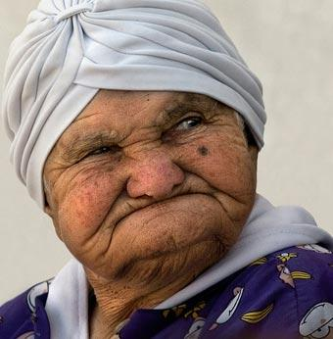
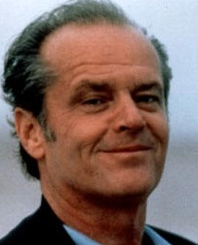
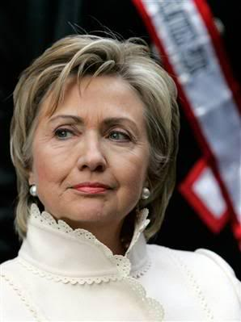
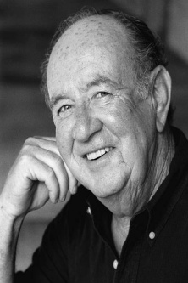
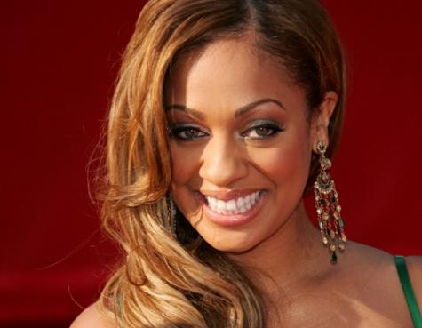
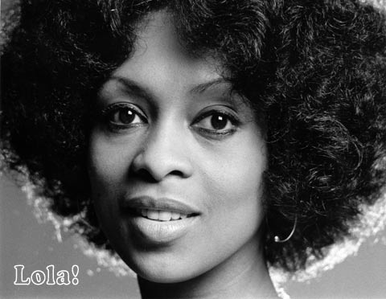
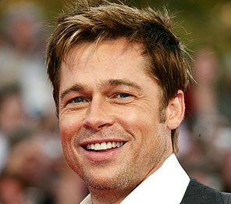
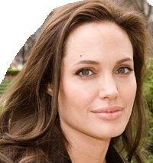
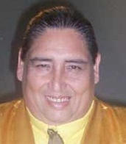
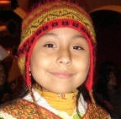

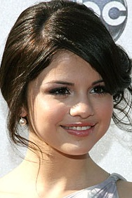
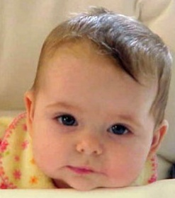
Linda
Jack
Hillary
Hilario
Lala
Lola
Brad
Angelina
Tongo
Luciano
Justin
Selena
Adriana

Slide 4
Is Angelina studying French?
No, she isn´t.
Do Justin and Selena have a dog?
Yes, they do
Does Lala work?
No, she doesn´t. She studies International Business.
Does Brad smoke?
No, he doesn´t.

